Slide 1
Discrete Mathematics greatest common divisor, infinity of primes, equivalence relation, equivalence class, congruence, mod
Liangfeng Zhang
School of Information Science and Technology
ShanghaiTech University

Slide 2
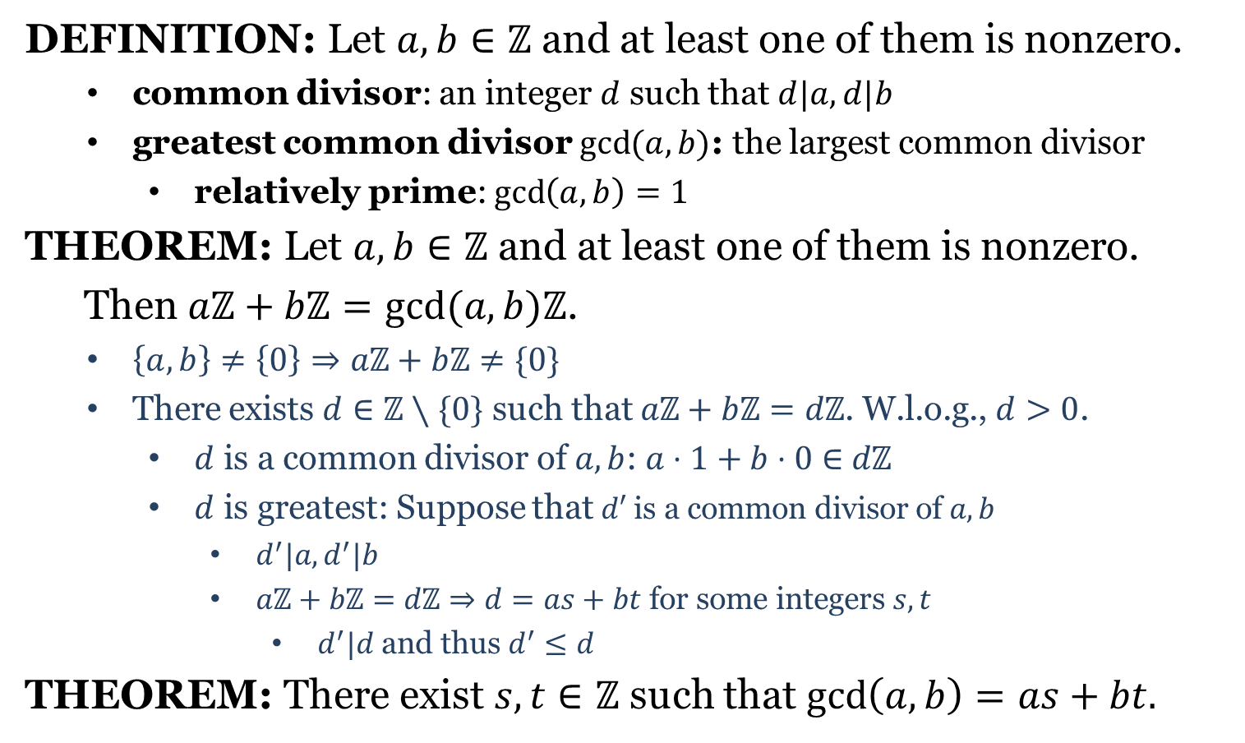
Greatest Common Divisor
DEFINITION: Let $a,b∈ℤ$ and at least one of them is nonzero.
common divisor: an integer $d$ such that $d|a, d|b$
greatest common divisor $\gcd{(a,b)}$: the largest common divisor
relatively prime: $\gcd\left(a,b\right)=1$
THEOREM: Let $a,b∈ℤ$ and at least one of them is nonzero.
Then $aℤ+bℤ=gcd(a,b)ℤ$.
$\left\{a,b\right\}≠\left\{0\right\}⇒aℤ+bℤ≠\{0\}$
There exists $d∈ℤ∖\{0\}$ such that $aℤ+bℤ=dℤ$. W.l.o.g., $d>0$.
$d$ is a common divisor of $a,b$: $a⋅1+b⋅0∈$ $dℤ$
$d$ is greatest: Suppose that $d′$ is a common divisor of $a,b$
$d^{′}|a, d^{′}|b$
$aℤ+bℤ=dℤ⇒d=as+bt$ for some integers $s,t$
$d^{′}|d$ and thus $d^{′}≤d$
THEOREM: There exist $s,t∈ℤ$ such that $\gcd\left(a,b\right)=as+bt.$

Slide 3
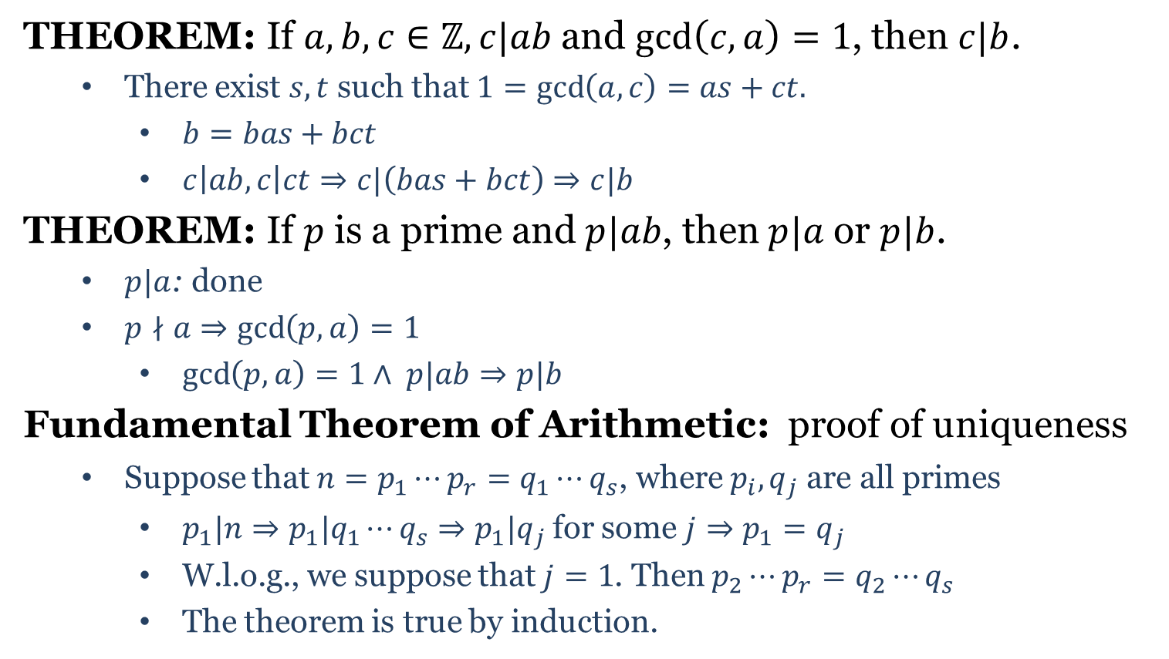
FTA Proof
THEOREM: If $a,b,c∈ℤ, c|ab$and $\gcd\left(c,a\right)=1$, then $c|b$.
There exist $s,t$ such that $1=\gcd\left(a,c\right)=as+ct.$
$b=bas+bct$
$c\left|ab, c\right|ct⇒c|\left(bas+bct\right)⇒c|b$
THEOREM: If $p$ is a prime and $p|ab$, then $p|a$ or $p|b$.
$p|a$: done
$p∤a⇒\gcd\left(p,a\right)=1$
$\gcd\left(p,a\right)=1∧ p|ab⇒p|b$
Fundamental Theorem of Arithmetic: proof of uniqueness
Suppose that $n=p_{1}⋯p_{r}=q_{1}⋯q_{s}$, where $p_{i},q_{j}$are all primes
$p_{1}|n⇒p_{1}|q_{1}⋯q_{s}⇒p_{1}|q_{j}$for some $j⇒p_{1}=q_{j}$
W.l.o.g., we suppose that $j=1$. Then $p_{2}⋯p_{r}=q_{2}⋯q_{s}$
The theorem is true by induction.

Slide 4
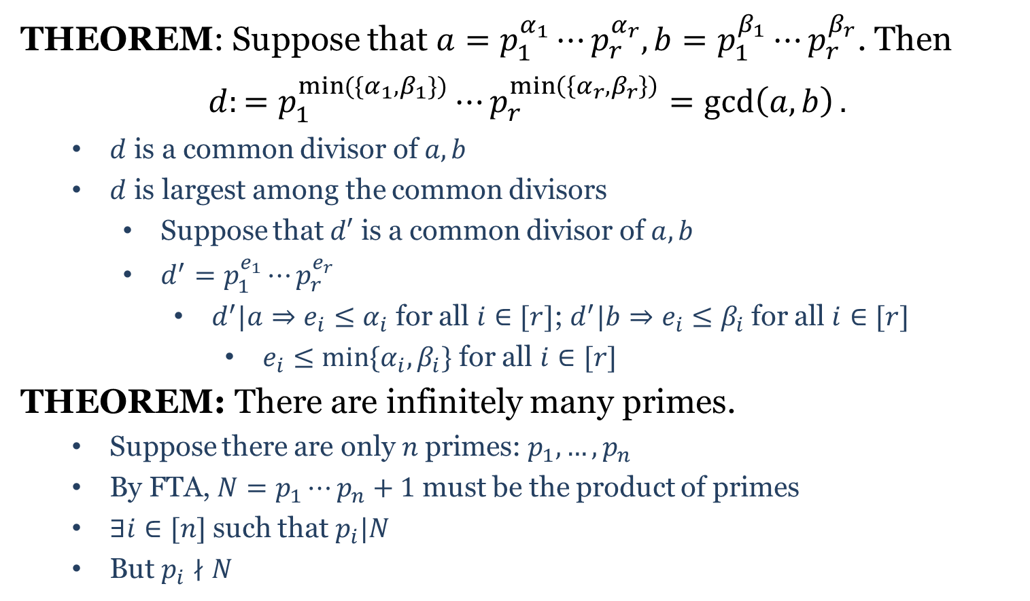
FTA Applications
THEOREM: Suppose that $a=p_{1}^{α_{1}}⋯p_{r}^{α_{r}}, b=p_{1}^{β_{1}}⋯p_{r}^{β_{r}}$. Then
$d:=p_{1}^{\min{(\{α_{1},β_{1}\})}}⋯p_{r}^{\min\left(\left\{α_{r},β_{r}\right\}\right)}=\gcd\left(a,b\right).$
$d$ is a common divisor of $a,b$
$d$ is largest among the common divisors
Suppose that $d′$ is a common divisor of $a,b$
$d^{′}=p_{1}^{e_{1}}⋯p_{r}^{e_{r}}$
$d^{′}|a⇒e_{i}≤α_{i}$ for all $i∈[r]$; $d^{′}|b⇒e_{i}≤β_{i}$ for all $i∈[r]$
$e_{i}≤min⁡\{α_{i},β_{i}\}$ for all $i∈[r]$
THEOREM: There are infinitely many primes.
Suppose there are only 𝑛 primes: $p_{1},…,p_{n}$
By FTA, $N=p_{1}⋯p_{n}+1$ must be the product of primes
$∃i∈[n]$ such that $p_{i}|N$
But $p_{i}∤N$

Slide 5
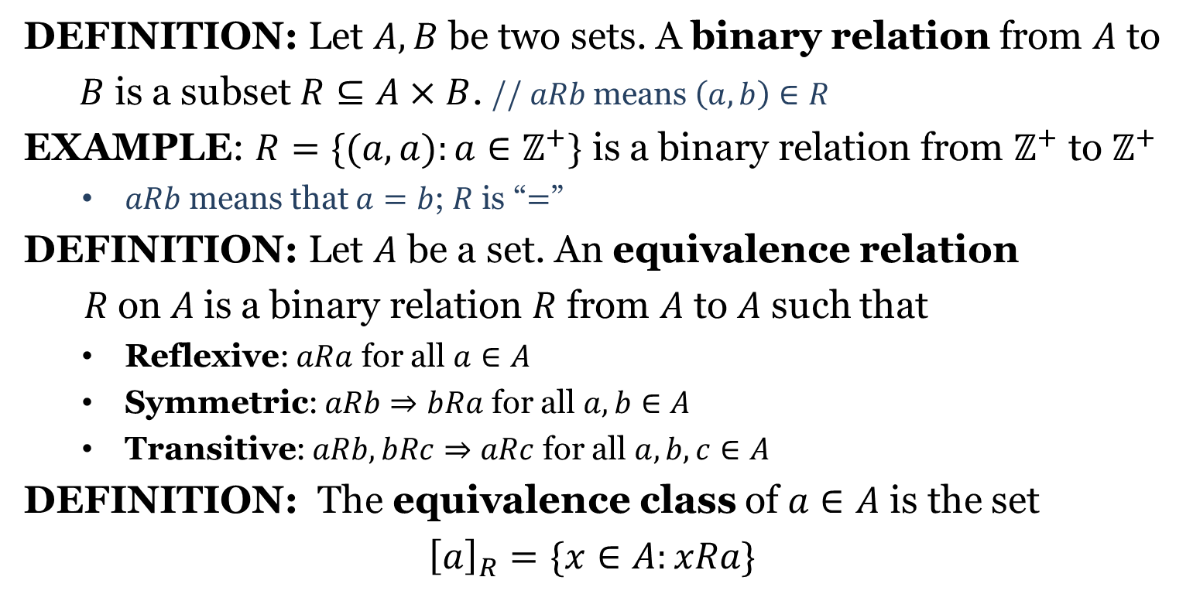
Equivalence Relation
DEFINITION: Let $A, B$ be two sets. A binary relation from $A$ to
$B$ is a subset $R⊆A×B$. // $aRb$means $\left(a,b\right)∈R$
EXAMPLE: $R=\{(a,a):a∈ℤ^{+}\}$ is a binary relation from $ℤ^{+}$ to $ℤ^{+}$
$aRb$ means that $a=b$; $R$ is “$=$”
DEFINITION: Let $A$ be a set. An equivalence relation
$R$on$A$is a binary relation $R$ from $A$ to $A$ such that
Reflexive: $aRa$ for all $a∈A$
Symmetric: $aRb⇒bRa$ for all $a,b∈A$
Transitive: $aRb,bRc⇒aRc$ for all $a,b,c∈A$
DEFINITION: The equivalence class of $a∈A$ is the set
$${\left[a\right]}_{R}=\{x∈A:xRa\}$$

Slide 6
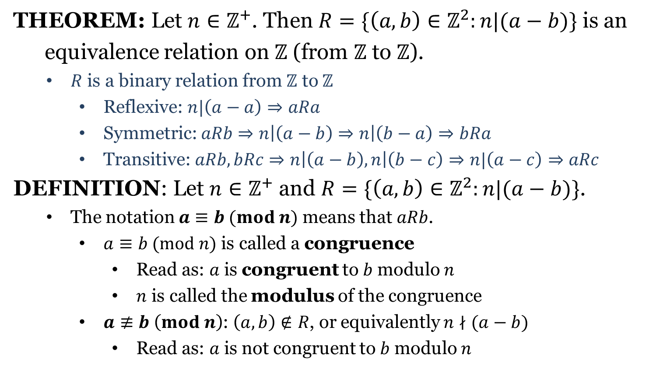
Congruence
THEOREM: Let $n∈ℤ^{+}$. Then $R=\{\left(a,b\right)∈ℤ^{2}:n|(a−b)\}$ is an
equivalence relation on $ℤ$ (from $ℤ$ to $ℤ$).
$R$ is a binary relation from $ℤ$ to $ℤ$
Reflexive: $n|\left(a−a\right)⇒aRa$
Symmetric: $aRb⇒n\left|\left(a−b\right)⇒n\right|\left(b−a\right)⇒bRa$
Transitive: $aRb, bRc⇒n\left|\left(a−b\right), n\right|\left(b−c\right)⇒n|\left(a−c\right)⇒aRc$
DEFINITION: Let $n∈ℤ^{+}$ and $R=\{\left(a,b\right)∈ℤ^{2}:n|(a−b)\}$.
The notation $a≡b (mod n)$ means that $aRb$.
$a≡b (mod n)$ is called a congruence
Read as: $a$ is congruent to $b$ modulo $n$
$n$ is called the modulus of the congruence
$a≢b \left(mod n\right)$: $\left(a,b\right)∉R$, or equivalently $n∤(a−b)$
Read as: $a$ is not congruent to $b$ modulo $n$

Slide 7
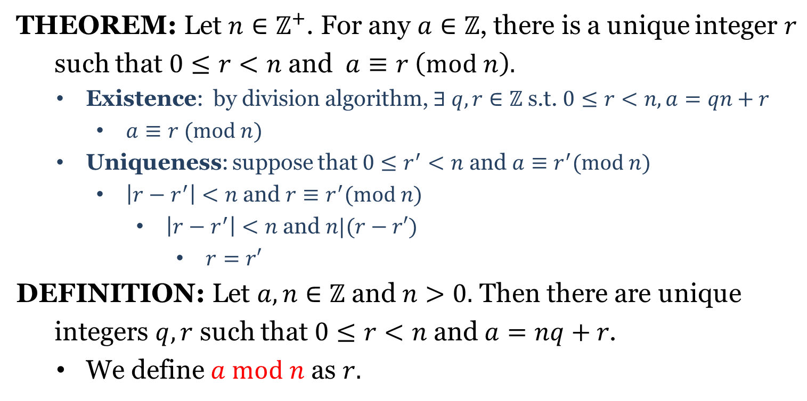
Congruence
THEOREM: Let $n∈ℤ^{+}$. For any $a∈ℤ$, there is a unique integer $r$
such that $0≤r<n$ and $a≡r \left(mod n\right).$
Existence: by division algorithm, $∃ q,r∈ℤ$ s.t. $0≤r<n, a=qn+r$
$a≡r (mod n)$
Uniqueness: suppose that $0≤r^{′}<n$ and $a≡r^{′}(mod n)$
$\left|r−r^{′}\right|<n$ and $r≡r^{′}(mod n)$
$\left|r−r^{′}\right|<n$ and $n|(r−r′)$
$r=r′$
DEFINITION: Let $a,n∈ℤ$ and $n>0.$ Then there are unique
integers $q,r$ such that $0≤r<n$ and $a=nq+r$.
We define $a mod n$ as $r.$

